Slide 1
Fundamental Programming Structure
Rajasekaran. S
Assistant Professor
Dept of IT

Slide 2
First Java Program Say Hello to World
import java.io.*;
public class Main {
public static void main(String[] args){
System.out.println(“Hello World”);
}
}

Slide 3
Checking for Java and Javac
Check for Java Compiler and Java Interpreter is properly installed on your system.
Open CMD Prompt
Type javac
If you prompt with option’s then javac is available.
Else you will be prompt with javac command not found jdk package not installed and proceed with jdk installation.

Slide 4
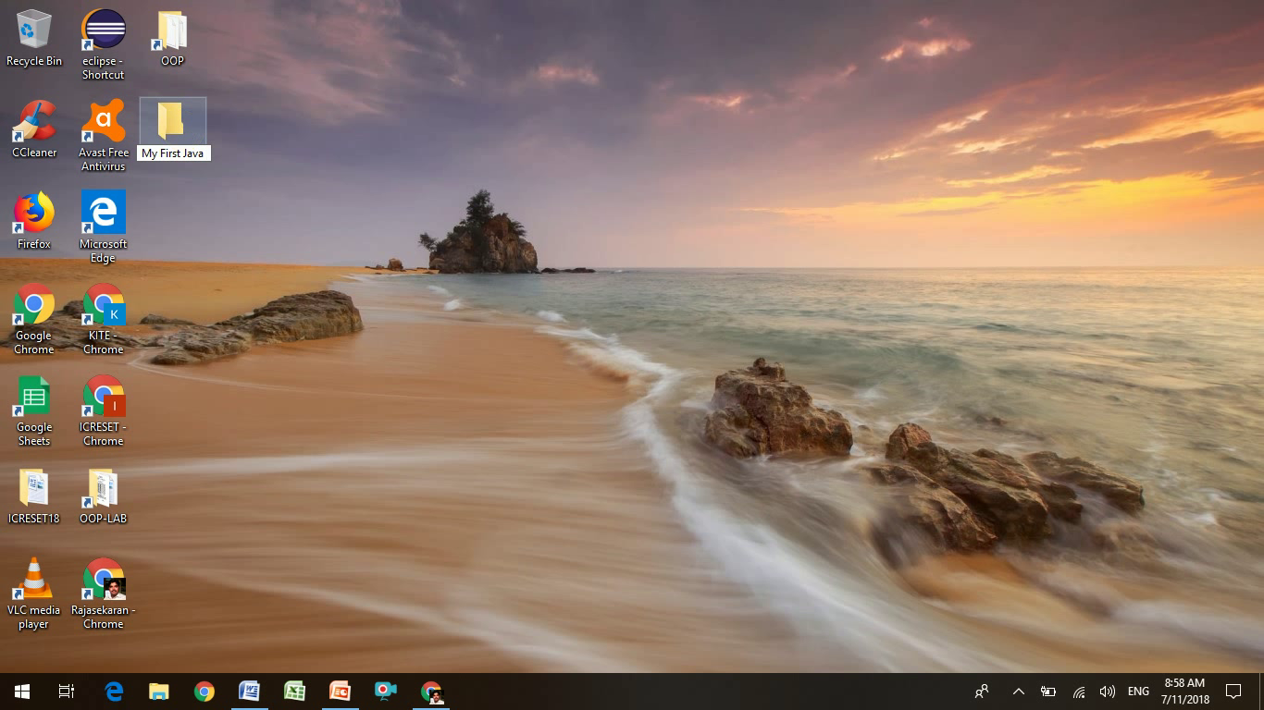
Creating Folders for My Program

Slide 5
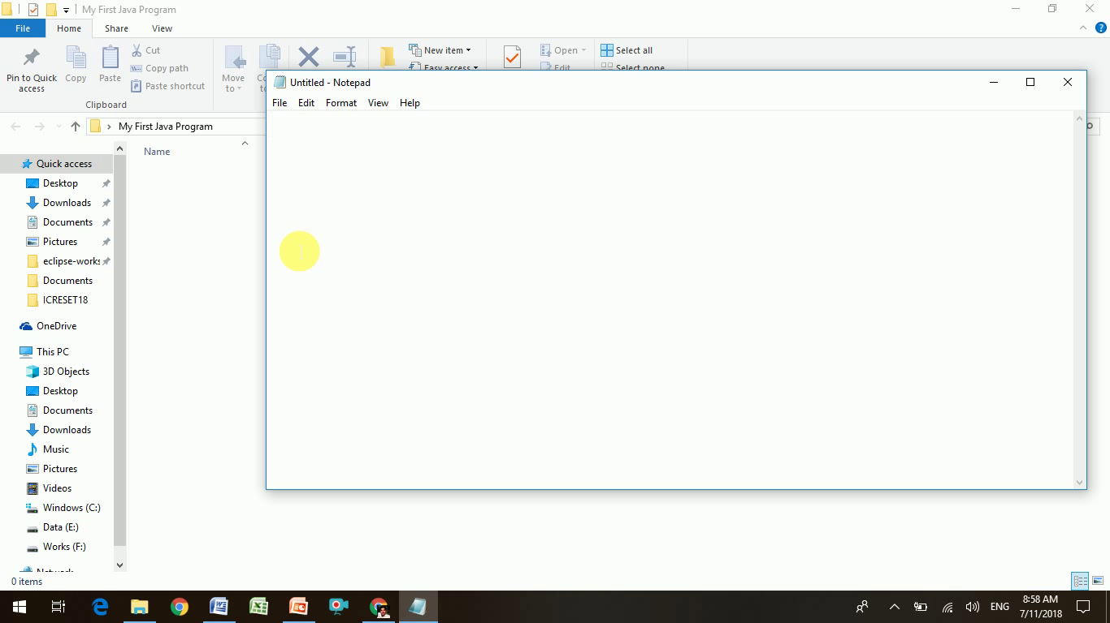
Open Notepad

Slide 6
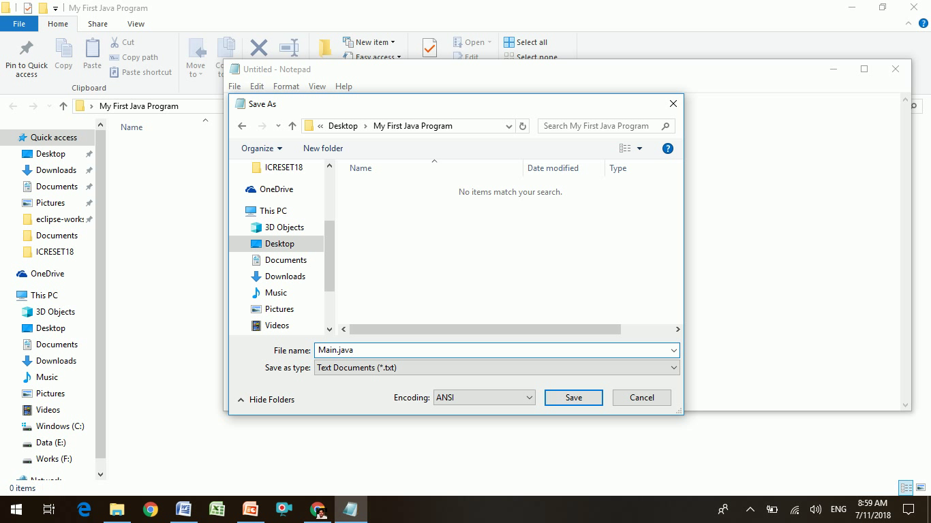
Rule 1: File name must resemble class name.
Saving File as Main.java

Slide 7
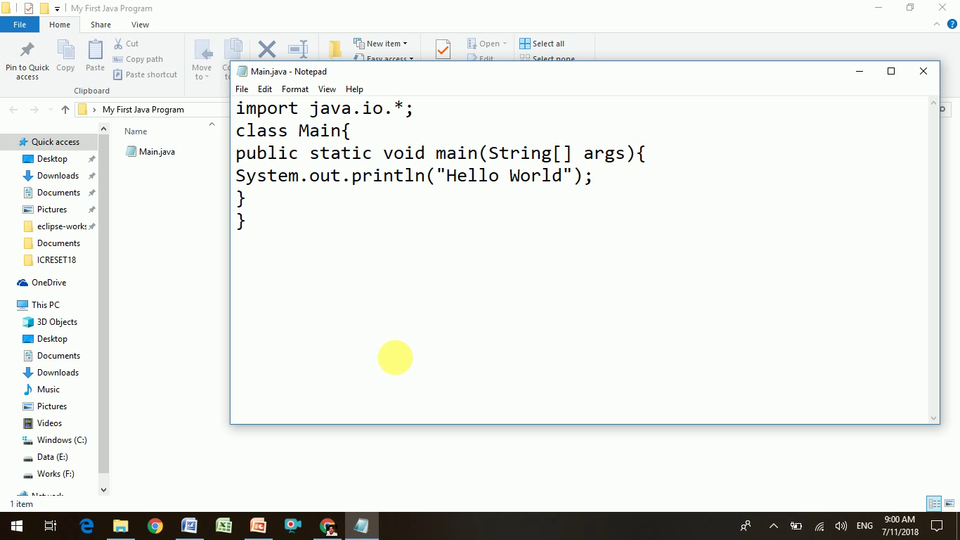
Creating Your First Program

Slide 8
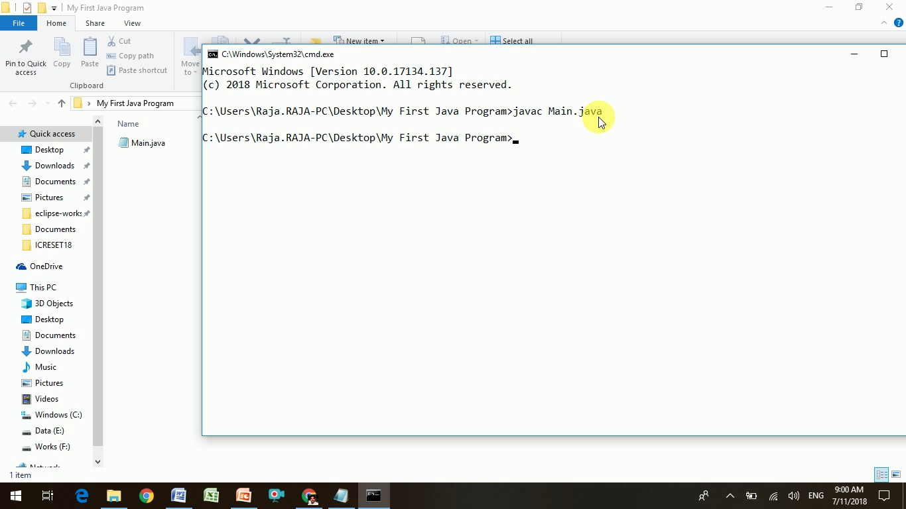
javac Main.java
Compiling Main.java

Slide 9
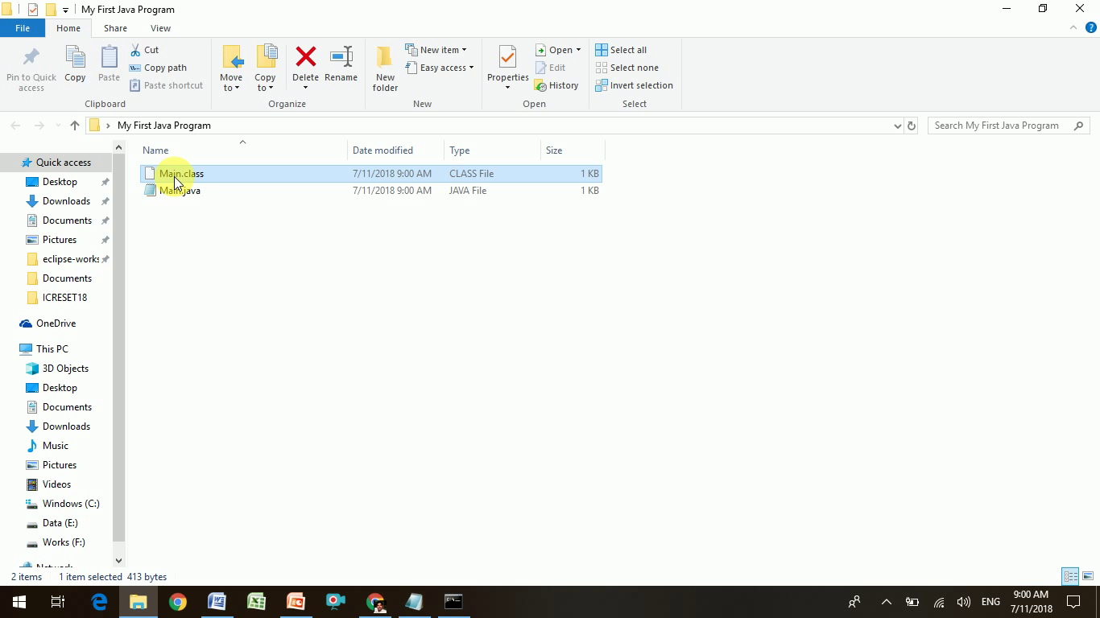
What is Main.class ?

Slide 10
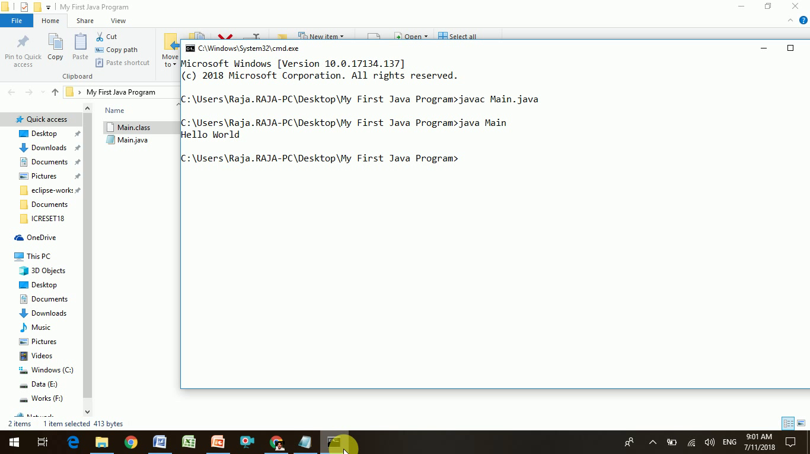
Running Java Program
java Main

Slide 11
https://youtu.be/rrrWZXbMuUw
Live Demo
Linux
Windows
https://youtu.be/hpOkLHWe5DY

Slide 12
Java Comments
It is a programmer-readable explanation or annotation in the source code of a computer program.
It help’s to understand the source code.
It is ignored by compilers and interpreters.

Slide 13
How to Comment in Java?
import java.io.*;
public class Main {
public static void main(String[] args){
System.out.println(“Hello World”);
}
}
//This will print hello world in console;
Single Line Comment

Slide 14
How to Comment in Java?
import java.io.*;
public class Main {
public static void main(String[] args){
System.out.println(“Hello World”);
}
}
/*
*@author Rajasekaran S
*@version 1.0
*Program Says hello to the world
*/
Multi Line Comment
//This will print hello world in console
Single Line Comment

Slide 15
Thank You
Rajasekaran S
Assistant Professor
Dept of IT

